Slide 1

Movie Tickets Booking Management System
Y.Ramana

Slide 2
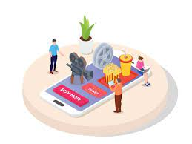
Synopsis:
The project objective is to book cinema tickets in online. The “Movie Tickets Booking Management System” is an Internet based application that can be accessed throughout the Net and can be accessed by anyone who has a net connection. This application will reserve the tickets. This “Movie Tickets Booking Management System” provides a website for a cinema hall ticket counter where any user of internet can access it.

Slide 3

Abstract:
History
Of crime
Ticket reservations are done using credit card and can be cancelled if needed. Our Movie Tickets Booking Management System is one of the best opportunities for those who cannot afford enough time to get their tickets reserved standing in long queues.
People can book tickets online at any time of day or night. Thus, Users can book tickets efficiently.

Slide 4
01
04
ALGORITHMS:
USER REQUIREMENT SPECIFICATION:
02
05
CONCLUSION:
06
IMPLEMENTATION PROCESS:
03
SUGGESTIONS FOR IMPROVEMENT:
INTRODUCTION:

Slide 5
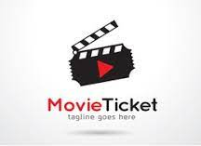
01
INTRODUCTION:

Slide 6
The project “Movie Ticket Booking System” as a wide scope as it is generalized software. This project can save money and efforts in managing the record, just a mouse click can make the task easy and faster. Customers may view the contents of any movie show at any time and may book any movie ticket as needed.
The program can be made accessible online for convenience of customers so, they can book tickets online at any time of day or night.

Slide 7
Customers may view the contents of any movie show at any time and may book any movie ticket as needed.
The program automatically calculates the subtotal and grand total. When a visitor decides to finally book the ticket, the order information including the address or location of the theatres and total payment has been made from the given input seats.
This project is being developed keeping in mind the general people who one has very little knowledge of computer operation.

Slide 8

02
USER REQUIREMENT SPECIFICATION:

Slide 9
User requirement Specification:
Based on system study following user requirements has been observed:
Customer should have facility to see list of movies running in that multiplex at present time, their show timing, booking status, multiplex location etc.
Customer should be allowed to see booking status of any movie and also book show of any date.
Customer should be allowed to take print of ticket, view their booked tickets.

Slide 10
SYSTEM REQUIREMENT:
* Hardware Specification Server: Processor-5th generation i3 RAM-128MB (min) Hard disk-20GB
Client: Processor-5th generation i3 Ram-128MB (min) Hard disk- 20GB
* Software Specification Platform - Windows 6,7,8 and 10.

Slide 11
03
IMPLEMENTATION PROCESS:

Slide 12
IMPLEMENTATION PROCESS:
The Movie Ticket Booking System is built on the idea of creating movie records and adding and updating them. Here, users may add movie titles, ticket prices, and release dates in a secure and time-saving manner. This system makes it simple to keep track of each and every employee's data. The entire project was created in the “python” programming language, and several variables and strings were employed in its construction. The consumers will find this little project simple to use and comprehend.

Slide 13
Approach:
Below is the approach to do the above operations:
•# this t_movie function is used to select movie name.
def t_movie():
•# this theater function used to select screen.
def theater():
•# this timing function used to select timing for movie.
def timing(a):
•# this movie(theatre) used to select movies accordingly to the theatre.
def movie(theater):
•# this center() function used to select the theatre.
def center():
•# this function is used to select city.
def city():

Slide 14

04
ALGORITHMS:

Slide 15
Simple Algorithm:
step 1: Start
step 2: Firstly, we invoke a function "city" to select the location.
step 3: Next, we have to select the name of the theatre using the function "center".
step 4: Now, we have to select the name of the movie using the function "t_movie".
step 5: Let us select the screen using the function "theatre".
step 6: Now select the time using the function "timing”, according to the screen we have chosen.
step 7: Price will be displayed; choose the number of tickets you want.
step 8: Now the cost of the movie tickets will be displayed.
step 9: Finally, your booking details will be displayed on the screen.
step 10: If you wish to continue, go to step 2.
step 11: Stop.

Slide 16
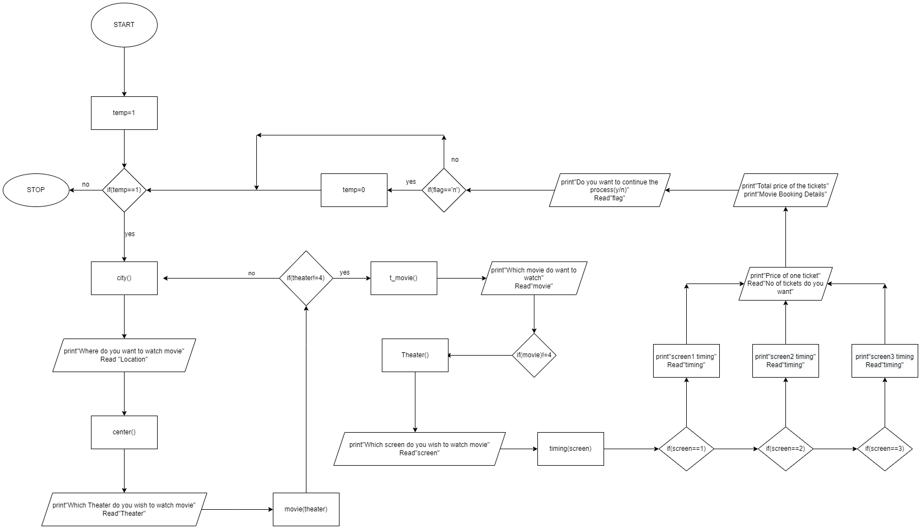
Flow Chart:

Slide 17
05
CONCLUSION:

Slide 18
Conclusion:
Nowadays, traditional reservation ways of cinema ticketing are dying. Its new age where technology dominates human life. With the software and technological devices, exceptions are reduced and even terminated. Also, people prefer easy, quick and safe way for every part of his life. This project is designed to meet the requirements of a cinema ticket booking system.
In our project: with this cinema ticketing system; cinema companies can satisfy comfortable facilities to their customers. With this platform we developed, we are hoping to reduce time wasting, avoid misunderstandings, provide easy data flow, customer pleasure, and less hard work. We believe that we have accomplished our goals and satisfied with the code we developed.

Slide 19

06
SUGGESTIONS FOR IMPROVEMENT:

Slide 20
Suggestions:
1.The program should be able to perform new features such as online payment billings i.e., net banking, cancelation of ticket, Admin module for management purpose and need to provide attractive offers on food combos, tickets.
2.The program can be made accessible online for convenience of customers so, they can book tickets online at any time of day or night.
3.The program can be made more user friendly by using a graphical interface to interact with the user, allowing the user to choose options by mouse-click action rather than having to type in the preferred choice.
4.The program could have been made short by simplifying it by employing simpler coding and using more built-in functions.

Slide 21
5.Also need to display graphical display of seats available and a function for selection of seats by user from the available seats.
6.A program to store the member details. Hence, when the user reopens the program, he can find his saved information and previous and current booking details.

Slide 22

THANKS!
Do you have any questions?
Plz, ASK!!

